Slide 1
THE NEAR.FINANCE WHITEPAPER

Slide 2
NEAR.FINANCE
Near.Finance is a community driven auto farming, DAO defined platform. The future of reflection tokens. All $NRF holders are integrated into the farming protocol to yield a percentage daily according to their holdl amount (units). This is done by Holdling rewards of more $NRF tokens.

Slide 3
OUR MISSION
The future of reflection tokens.
To build a community driven by auto farming protocol.
to integrate All $NRF holders into the farming protocol to yield a percentage daily according to their holdl amount.
To achieve equality in distribution of $NRF tokens to all airdrop participants.

Slide 4
BIG CONCEPT
It rewards its holdlers two percent of their holding in reflection daily.

Slide 5
NEAR.FINANCE TOKENS
NAME | Near Finance Token
TOTAL TOKENS | 1,000,000
CONTACT ADDRESS | 0x39cb1839942074894a176a59e5f54f0b1cf8b493
SYMBOL | NRF
DECIMAL | 18
BLOCKCHAIN | Binance Smart Chain

Slide 6
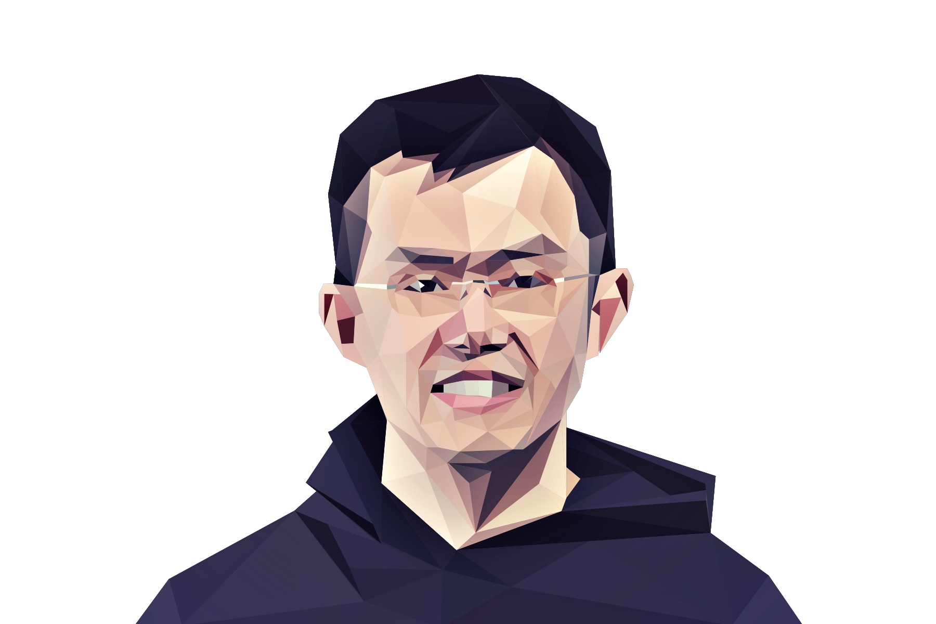
“We think that crypto has a very strong use case in less developed countries… there’s more money to be made in a more developed country, but we want to distribute crypto to the rest of the world.”
CZ Binance

Slide 7

NEAR FINANCE Functionalities

Slide 8
BENEFITS
Utility 1
Easy to entry participation for staking. Stable and worthy sustainable APY.
Utility 2
Tokens are in holders’ management and can be accessed at any time. integration.
Utility 3
Real-time spending of $NRF anywhere at any time in the world, provided by Chi-spend API
Utility 4
Near Finance Protocol is an Auto-non committed staking Protocol.
Utility 5
Near Finance Protocol intends to disrupt the native savings in the financial system.
Utility 6
Innovative blockchain based replacement for traditional savings.

Slide 9
BENEFITS
Utility 7
$NRF holders are automatically given first-hand information and the opportunity to invest in future NFT, Metaverse project and also partnered cryptocurrency projects.
Utility 8
Tokens are in holders’ management and can be accessed at any time. integration.
Utility 9
The normal staking protocols can be seized or stopped at any time or require third party pools, or smart contract to hold staked tokens. This way putting the protocol at risk of being hacked.

Slide 10
TOKENOMICS
ITO (Initial Token Offering)
Reward System
Liquidity
Airdrop
Marketing Division
Development Division
DAO, NFT and Metaverse Development

Slide 13
ITO
This give ITO stage, first of its kind in the crypto asset distribution space, allows early investors to have access to the Near.Finance DAO/Governance whitelist platform. This gives only ITO participants DAO power to vote and make decisions for the platform.
Token Allocation for ITO: 200,000 $NRF Tokens
Hardcap: 300 BNB
Softcap: 100 BNB

Slide 14
ITO
Maximum Buy: 3 BNB
Minimum Buy: 0.01 BNB
Price:
1 BNB= 666 $NRF
0.01 BNB= 6.66 $NRF
Liquidity Pool:
100,000 $NRF/ 250 BNB
10,000 $NRF/ 50 BNB

Slide 15
PROJECTED ROI FROM ITO
PROJECTED ROI IN 6MONTHS FROM ITO
1 $NRF: $ 0.23 (ITO Stage)
1 $NRF: $ 670
Approximately: 291,204% ROI
A $1000 invested in ITO stage, could yield you $2.9 million

Slide 16
REWARD
Token Allocation for Reward:
400,000 $NRF tokens
Duration: Two Years

Slide 17
PHASE 1
Token Allocation for phase 1: 300,000 $NRF tokens
Duration: 365 days
Reward per day: 821 $NRF tokens.
Snapshot of token holders will be taken daily.
Distribution of reward tokens (refs) every 3 days.

Slide 18
DISTRIBUTION/REWARD RANK
Holdler's of 10000 $NRF and above = 50% of the daily reward
Holdler's of 1000 $NRF and above = 25% of the daily reward
Holdler's of 100 $NRF and above = 15% of the daily reward
Holdler's of 10 $NRF and above = 10% of the daily reward

Slide 19
PHASE 2
Token Allocation for phase 2: 100,000 $NRF tokens
Duration: 365 days
Reflection per day: 273 $NRF tokens.
Snapshot of token holders will be taken.
Distribution of farm tokens (refs) every 10 days.

Slide 20
DISTRIBUTION/ REWARD RANK
Holdler's of 100,000 $NRF and above = 50% of the weekly reward
Holdler's of 10,000 $NRF and above = 30% of the weekly reward
Holdler's of 1,000 $NRF and above = 20% of the weekly reward

Slide 21
2. AIRDROP
For Community Building

Slide 22
100,000
Whoa! Distrubuted among all community participants
TOKENS

Slide 23
$50,124
1,000,000 addresses
100%
That’s a lot of money
And a lot of participants
Total success!

Slide 24
MARKETING DIVISION
MISSION 1
MISSION 2
MISSION 3
Awareness
Strategy
Listing
Partnership Sponsorship

Slide 25
MARKETING GOALS
AWARENESS
DISCOVERY
EVALUATION
INTENT
PURCHASE
LOYALTY

Slide 26
ROADMAP
Token development Community building
ITO stage 1 ITO stage 2
Airdrop distribution Liquidity pool creation (locked)
Phase 2 reward distribution Certik verification
Listing on DEX - Apeswap, MDEX (channel community voting)
Rebranding and website Redevelopment (web 3.0). Listing on CEX
Quarter One
Quarter Two
Quarter Three
Quarter Four
Social media creation BSc scan verification Website development
Listing on pancake swap, Forming reward contract release
Partnership NFT creation & release. Strategic partnership, marketing and sponsorship.
Channel community voting Cross chain bridge for avalanche, polygon, stellar, solana, algorand, cardano, fantom

Slide 27
LISTING & AUDIT PLATFORMS
On DEX, Swaps, CoinMarketcap, Coingecko, Trust wallet
DEX: Binance DEX
Swap: Pancakeswap, Apeswap
Centralized Exchange: Gate.io, Bybit, poloniex, MEXC, Liquid, upbit, bittrex.
BSCScan
Certik
Fairyproof
Slowmist
Quantstamp

Slide 28
DEVELOPMENT TEAM
Token Allocation 50,000 $NRF Tokens

Slide 29
THANK YOU

